Slide 1
Discrete-Time Fourier Transform
Notes:
The discrete-time Fourier transform allows Fourier analysis of aperiodic discrete-time signals, that is the representation of aperiodic discrete-time signals in the frequency-domain.

Slide 2
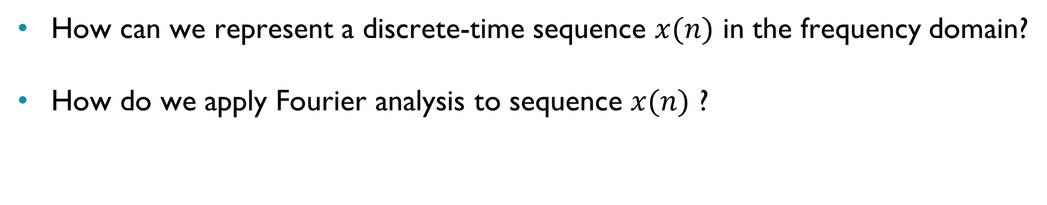
Discrete-Time Fourier Transform DTFT
How can we represent a discrete-time sequence $x(n)$ in the frequency domain?
How do we apply Fourier analysis to sequence $x(n)$ ?
Notes:
What is the frequency domain representation of the sampled signal $x(n)$?
And what is the nature of its frequency-domain representation?
So far we have looked at the Fourier analysis of continuous-time signals $x(t)$ , whether periodic or aperiodic, using the Fourier series and the Fourier transform respectively.
$x(n)$ is not a function of time but a sequence, or series, of numbers (discrete sample values).

Slide 3
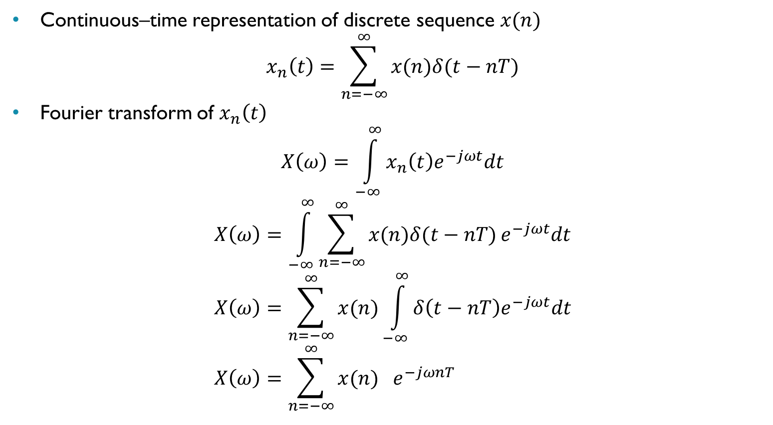
Discrete-Time Fourier Transform DTFT
Continuous–time representation of discrete sequence $x(n)$
$$x_{n}\left(t\right)=\sum_{n=−∞}^{∞}{x(n)δ(t−nT)}$$
Fourier transform of $x_{n}\left(t\right)$
$$X\left(ω\right)=\int_{−∞}^{∞}{x_{n}\left(t\right)e^{−jωt}dt}$$
$$X\left(ω\right)=\int_{−∞}^{∞}{\sum_{n=−∞}^{∞}{x(n)δ(t−nT)}e^{−jωt}dt} \\ X\left(ω\right)=\sum_{n=−∞}^{∞}{x(n)\int_{−∞}^{∞}{δ\left(t−nT\right)e^{−jωt}dt}} \\ X\left(ω\right)=\sum_{n=−∞}^{∞}{x(n) } e^{−jωnT}$$
Notes:
One way of applying Fourier analysis to a discrete-time signal $x(n)$ is to represent it as a continuous–time signal $x_{n}\left(t\right)$comprising a sum of weighted and time-shifted impulses as shown here, and then to apply the (continuous-time) Fourier transform.
The $n$th value in the discrete-time sequence is equal to the continuous-time signal (sampled) at time $t=nT$. The value of $x(t)$ at times other than at the sampling instants is not represented explicitly in $x(n)$.
The result (of applying the DTFT) is a (continuous) function of frequency $X\left(ω\right)$. $X\left(ω\right)$ is periodic with period $ω_{s}={2π}/T$ radians per second.

Slide 4
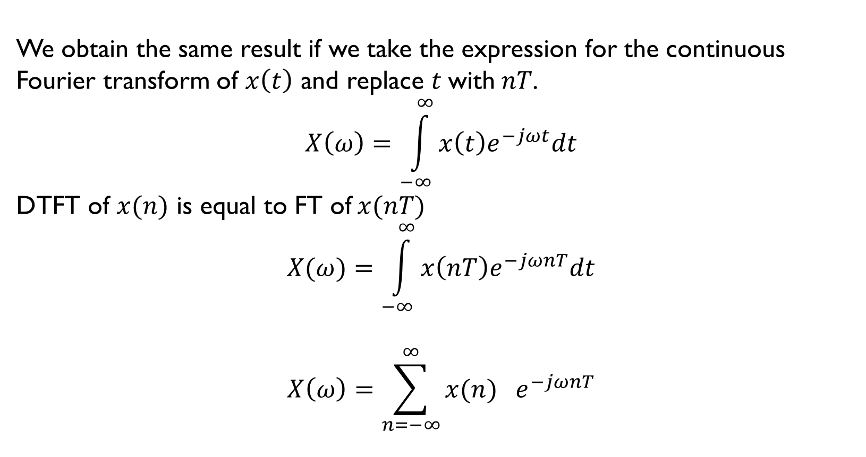
Discrete-Time Fourier Transform DTFT
We obtain the same result if we take the expression for the continuous
Fourier transform of $x\left(t\right)$ and replace $t$with$nT$.
$$X\left(ω\right)=\int_{−∞}^{∞}{x\left(t\right)e^{−jωt}dt}$$ DTFT of $x(n)$ is equal to FT of $x(nT)$
$$X(ω)=\int_{−∞}^{∞}{x\left(nT\right)e^{−jωnT}dt}$$
$$X\left(ω\right)=\sum_{n=−∞}^{∞}{x(n) } e^{−jωnT}$$
Notes:
Another (arguably simpler) way of deriving the DTFT is simply to substitute $nT$ for $t$ in an expression for the (continuous-time) Fourier transform of $x(t)$.
If we replace, or represent, continuous-time signal $x(t)$ by samples of $x(t)$ taken at regular intervals in time $t=nT$, where $n$ is an integer index and $T$ is the sampling period in seconds we obtain a discrete time signal or sequence $x\left(n\right)=x\left(nT\right)$.

Slide 5
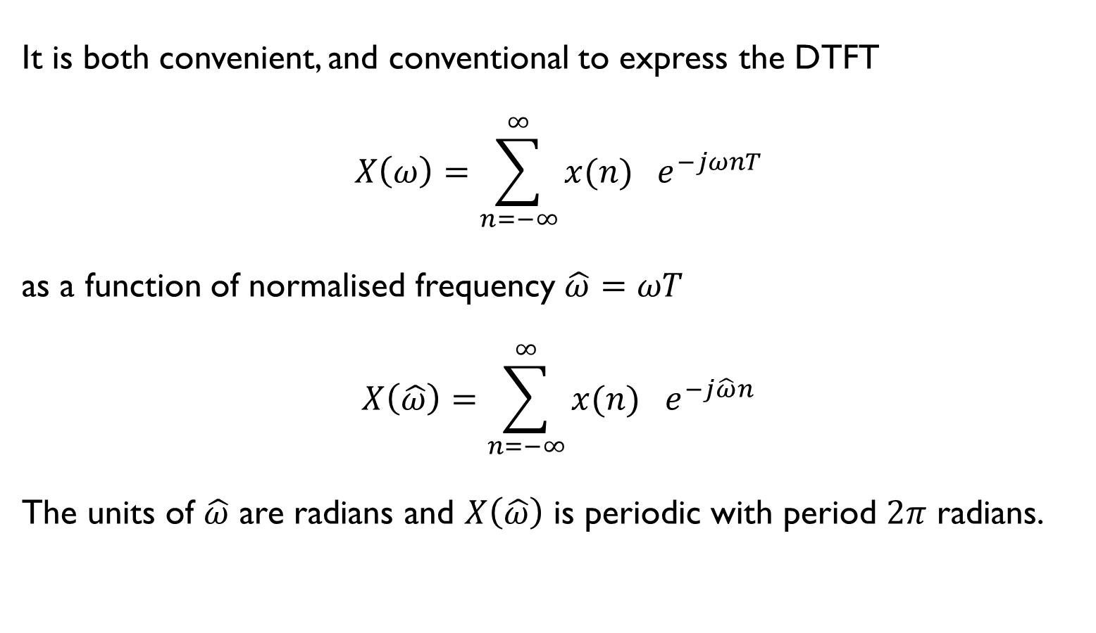
Discrete-Time Fourier Transform - Normalised Frequency
It is both convenient, and conventional to express the DTFT
$$X\left(ω\right)=\sum_{n=−∞}^{∞}{x(n) } e^{−jωnT}$$
as a function of normalised frequency $\hat{ω}=ωT$
$$X\left(\hat{ω}\right)=\sum_{n=−∞}^{∞}{x(n) } e^{−j\hat{ω}n}$$
The units of $\hat{ω}$ are radians and $X\left(\hat{ω}\right)$ is periodic with period $2π$ radians.
Notes:
What it says here.

Slide 6
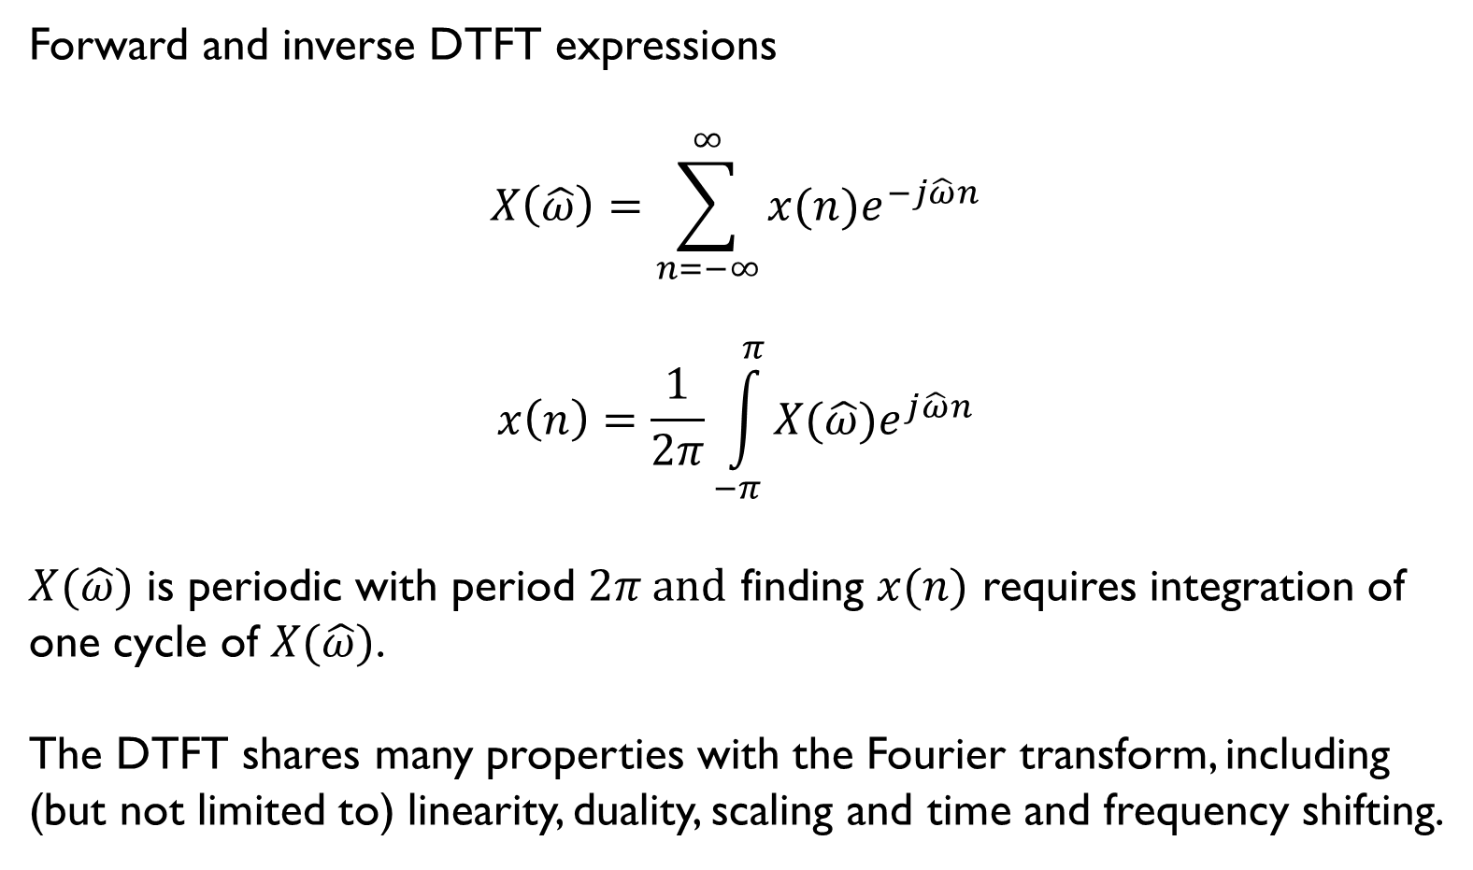
Discrete-Time Fourier Transform DTFT
Forward and inverse DTFT expressions
$$X\left(\hat{ω}\right)=\sum_{n=−∞}^{∞}{x(n)e^{−j\hat{ω}n}}$$
$$x\left(n\right)=\frac{1}{2π}\int_{−π}^{π}{X(\hat{ω})e^{j\hat{ω}n}}$$
$X(\hat{ω})$ is periodic with period $2π and$ finding $x(n)$ requires integration of
one cycle of $X(\hat{ω})$.
The DTFT shares many properties with the Fourier transform, including
(but not limited to) linearity, duality, scaling and time and frequency shifting.
Notes:
These two equations describe the forward (analysis) and inverse (synthesis) equations of the DTFT

Slide 7

Discrete-Time Fourier Transform - Linearity
Linearity
If $x_{1}\left(n\right) \underset{↔}{DTFT}{ X}_{1}\left(\hat{ω}\right)$ and $x_{2}\left(n\right) \underset{↔}{DTFT}{ X}_{2}\left(\hat{ω}\right)$
then ${ ax}_{1}\left(n\right)+{bx}_{2}\left(n\right) \underset{↔}{DTFT}{ aX}_{1}\left(\hat{ω}\right)+{bX}_{2}\left(\hat{ω}\right)$
Notes:
The discrete-time Fourier transform is linear. It obeys the law of superposition.

Slide 8
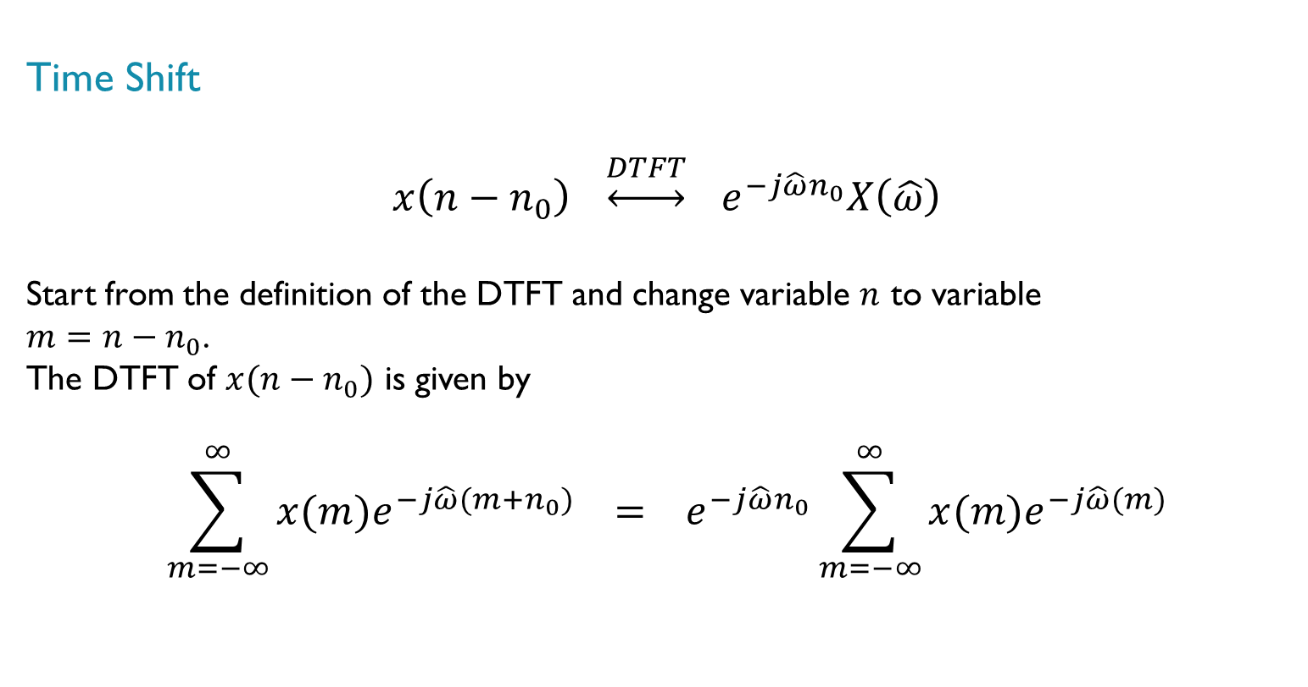
Discrete Time Fourier Transform DTFT – Time Shift
Time Shift
$$x\left(n−n_{0}\right) \underset{↔}{DTFT}{ e}^{−j\hat{ω}n_{0}}X\left(\hat{ω}\right)$$
Start from the definition of the DTFT and change variable $n$ to variable
$m=n−n_{0}$.
The DTFT of $x(n−n_{0})$ is given by
$$\sum_{m=−∞}^{∞}{x(m)e^{−j\hat{ω}(m+n_{0})}} = e^{−j\hat{ω}n_{0}}\sum_{m=−∞}^{∞}{x(m)e^{−j\hat{ω}(m)}}$$
Notes:
Shifting discrete-time sequence $x(n)$ by an integer number of sample positions $n_{0}$ in the time-domain corresponds to multiplying the DTFT of $x(n)$ , $X\left(\hat{ω}\right)$ by $e^{−j\hat{ω}n_{0}}$.
$e^{−j\hat{ω}n_{0}}$ is a complex quantity with unity magnitude. Multiplying by $e^{−j\hat{ω}n_{0}}$ effects a linear phase shift.

Slide 9

Discrete Time Fourier Transform DTFT – Frequency Shift
Frequency Shift
$$e^{−jn{\hat{ω}}_{0}}x\left(n\right) \underset{↔}{ DTFT} X\left(\hat{ω}−{\hat{ω}}_{0}\right)$$
The DTFT of $e^{−jn{\hat{ω}}_{0}}x(n)$ is equal to the DTFT of $x\left(n\right)$ using $\left(\hat{ω}−{\hat{ω}}_{0}\right)$ in place of $\left(\hat{ω}\right)$.
$$\sum_{n=−∞}^{∞}{e^{−jn{\hat{ω}}_{0}}x(n)e^{−j\hat{nω}}} = \sum_{n=−∞}^{∞}{x(n)e^{−jn(\hat{ω}−{\hat{ω}}_{0})}}$$
Notes:
Multiplying $x\left(n\right)$ by${ e}^{−jn{\hat{ω}}_{0}}$ in the time-domain results in a shift of ${\hat{ω}}_{0}$ in the frequency-domain.

Slide 10

Discrete-Time Fourier Transform - Periodicity
Periodicity
$$X\left(\hat{ω}+2π\right)=\sum_{n=−∞}^{∞}{x(n)e^{−jn\left(\hat{ω}+2π\right)}}$$
$$=\sum_{n=−∞}^{∞}{x(n)e^{−jn\hat{ω}}e^{−j2π}}$$
$$=\sum_{n=−∞}^{∞}{x(n)e^{−jn\hat{ω}}}$$
$$=X(\hat{ω})$$
Notes:
The period of the DTFT $X(\hat{ω})$ in the frequency domain ($2π$ radians) corresponds to the sampling frequency $ω_{s}$ of the discrete-time signal $x(n)$.

Slide 11
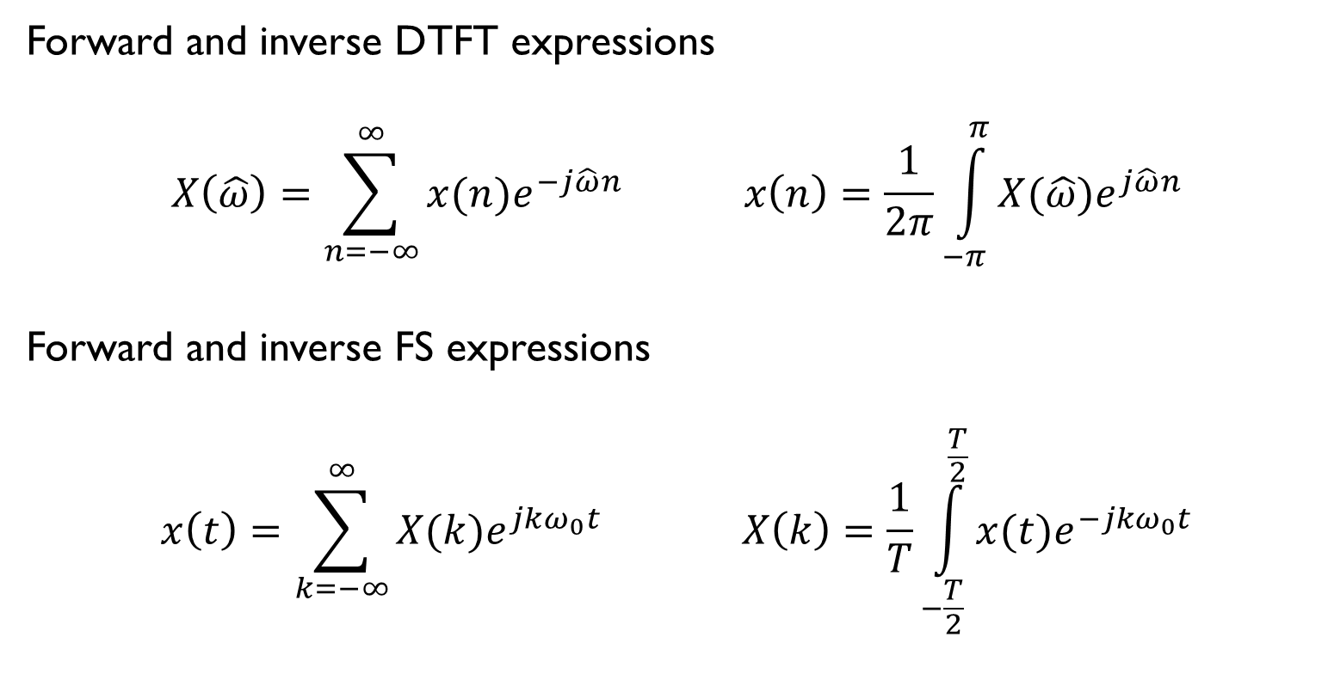
Discrete Time Fourier Transform - Duality
Forward and inverse DTFT expressions
$$X\left(\hat{ω}\right)=\sum_{n=−∞}^{∞}{x(n)e^{−j\hat{ω}n}} x\left(n\right)=\frac{1}{2π}\int_{−π}^{π}{X(\hat{ω})e^{j\hat{ω}n}}$$
Forward and inverse FS expressions
$$x\left(t\right)=\sum_{k=−∞}^{∞}{X(k)e^{jkω_{0}t}} X\left(k\right)=\frac{1}{T}\int_{−\frac{T}{2}}^{\frac{T}{2}}{x(t)e^{−jkω_{0}t}}$$
Notes:
The discrete-time Fourier transform is the dual of the Fourier series. Substitute $t$ for $−\hat{ω}$ , $x\left(t\right)$ for $X\left(\hat{ω}\right)$ , $T$ for $2π$ , and $X\left(k\right)$ for $x\left(n\right)$.

Slide 12
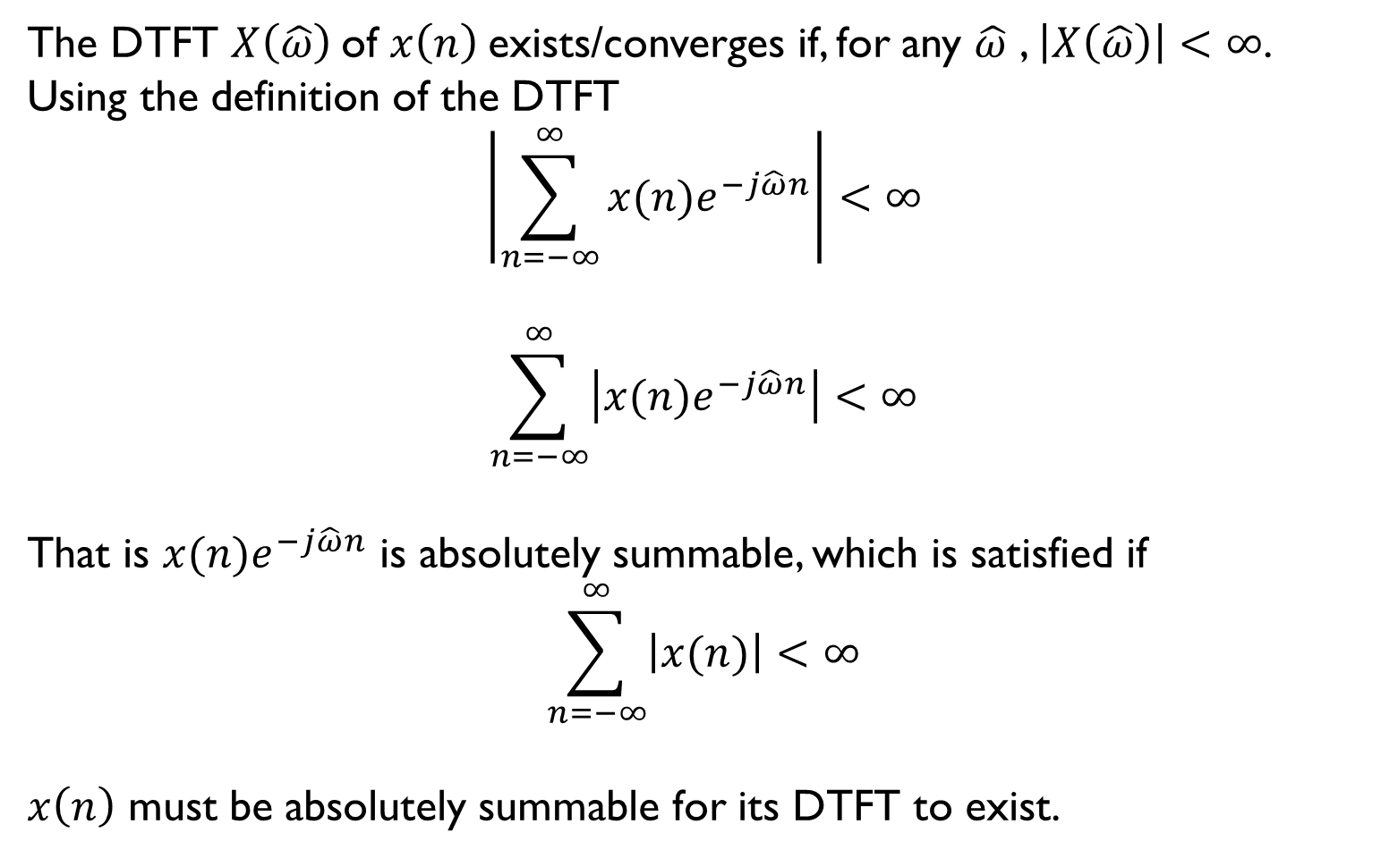
Discrete Time Fourier Transform - Existence
The DTFT $X\left(\hat{ω}\right)$of $x\left(n\right)$exists/converges if, for any $\hat{ω}$ , $\left|X\left(\hat{ω}\right)\right|<∞$.
Using the definition of the DTFT
$$\left|\sum_{n=−∞}^{∞}{x(n)e^{−j\hat{ω}n}}\right|<∞$$
$$\sum_{n=−∞}^{∞}{\left|x(n)e^{−j\hat{ω}n}\right|}<∞$$
That is $x(n)e^{−j\hat{ω}n}$ is absolutely summable, which is satisfied if
$$\sum_{n=−∞}^{∞}{\left|x(n)\right|}<∞$$
$x\left(n\right)$ must be absolutely summable for its DTFT to exist.
Notes:
A valid function should be finite for any value of its independent variable.
For the DTFT$X\left(\hat{ω}\right)$ to exist or converge, $x\left(n\right)$must be absolutely summable.
In other words, no value in the sequence $x\left(n\right)$ may be infinite in magnitude and the sequence $x\left(n\right)$ must either be finite in length or its values must decay towards zero as $n$ approaches plus or minus infinity.

Slide 13
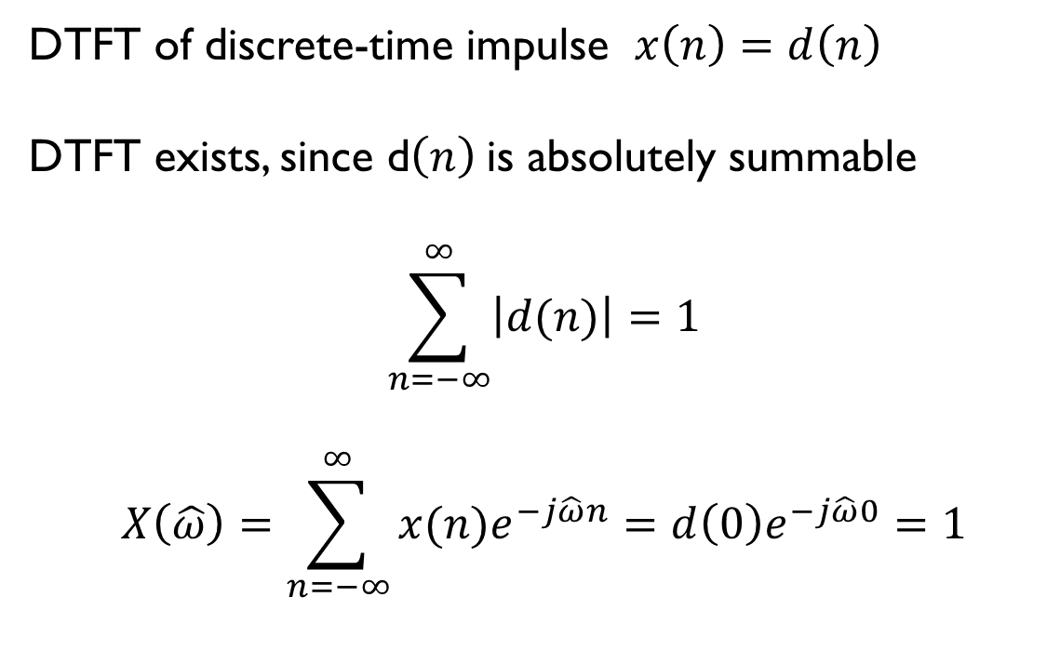
Discrete-Time Fourier Transform - Examples
DTFT of discrete-time impulse $x\left(n\right)=d\left(n\right)$
DTFT exists, since d$\left(n\right)$is absolutely summable
$$\sum_{n=−∞}^{∞}{\left|d(n)\right|}=1$$
$$X\left(\hat{ω}\right)=\sum_{n=−∞}^{∞}{x(n)e^{−j\hat{ω}n}}=d\left(0\right)e^{−j\hat{ω}0}=1$$

Slide 14
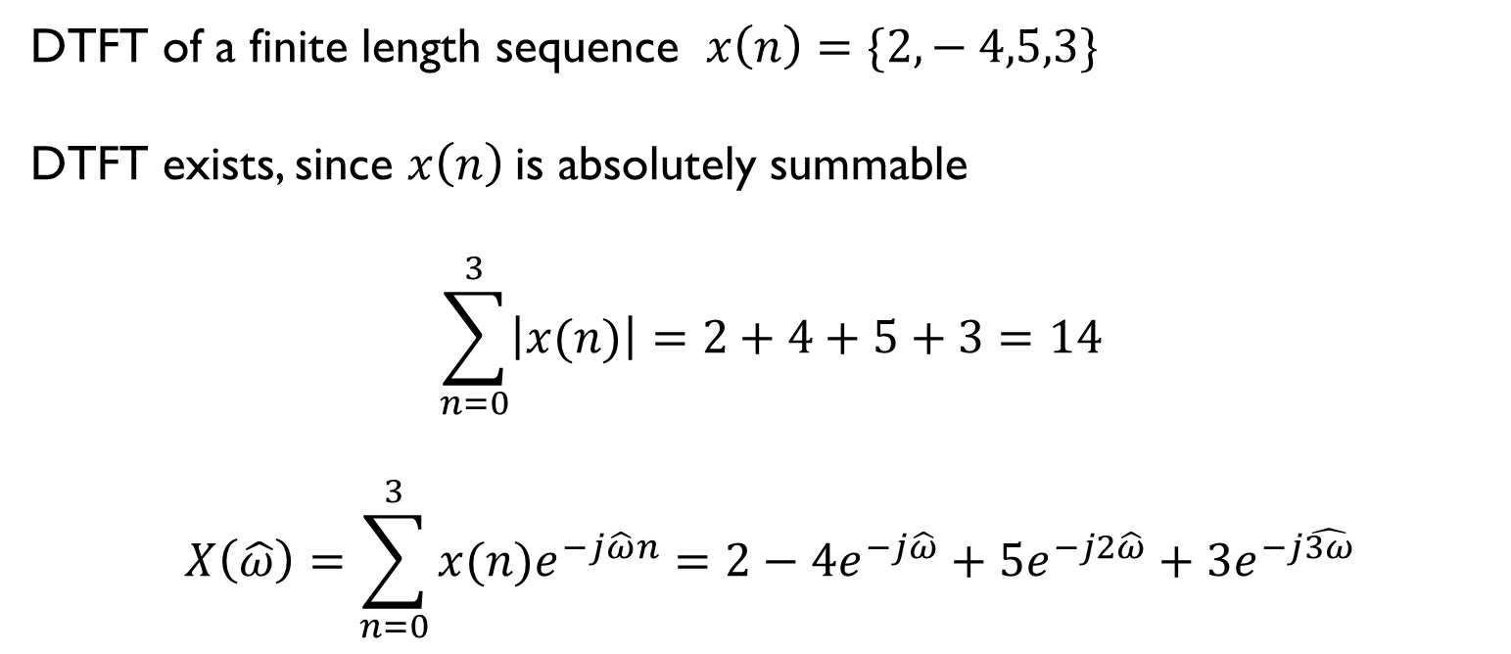
Discrete-Time Fourier Transform - Examples
DTFT of a finite length sequence $x\left(n\right)=\{2,− 4,5,3\}$
DTFT exists, since $x\left(n\right)$is absolutely summable
$$\sum_{n=0}^{3}{\left|x(n)\right|}=2+4+5+3=14$$
$$X\left(\hat{ω}\right)=\sum_{n=0}^{3}{x(n)e^{−j\hat{ω}n}}=2−4e^{−j\hat{ω}}+5e^{−j2\hat{ω}}+3e^{−j\hat{3ω}}$$

Slide 15


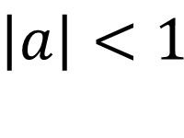


Discrete-Time Fourier Transform - Examples
DTFT of an infinite length sequence $x\left(n\right)=a^{n}u(n)$
By inspection, $x\left(n\right)$is absolutely summable only for $\left|a\right|<1$
$$x(n)$$
$$\left|a\right|<1$$
$$0$$
$$n$$
Notes:
The DTFT of an infinite length sequence $x(n)$ is possible if the value of $x(n)$ decays towards zero as $n$ tends to infinity.

Slide 16

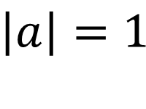
Discrete-Time Fourier Transform - Examples
DTFT of an infinite length sequence $x\left(n\right)=a^{n}u(n)$
By inspection, $x\left(n\right)$is absolutely summable only for $\left|a\right|<1$
$$x(n)$$
$$\left|a\right|=1$$
$$0$$
$$n$$
Notes:
If the value of $x(n)$ doesn’t decay towards zero as $n$ tends to infinity as, for example, in the case of a unit step function then the DTFT of $x(n)$ doesn’t exist.

Slide 17
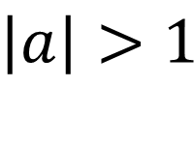
Discrete-Time Fourier Transform - Examples
DTFT of an infinite length sequence $x\left(n\right)=a^{n}u(n)$
By inspection, $x\left(n\right)$is absolutely summable only for $\left|a\right|<1$
$$x(n)$$
$$\left|a\right|>1$$
$$0$$
$$n$$
Notes:
The DTFT of this sequence doesn’t exist/converge.

Slide 18
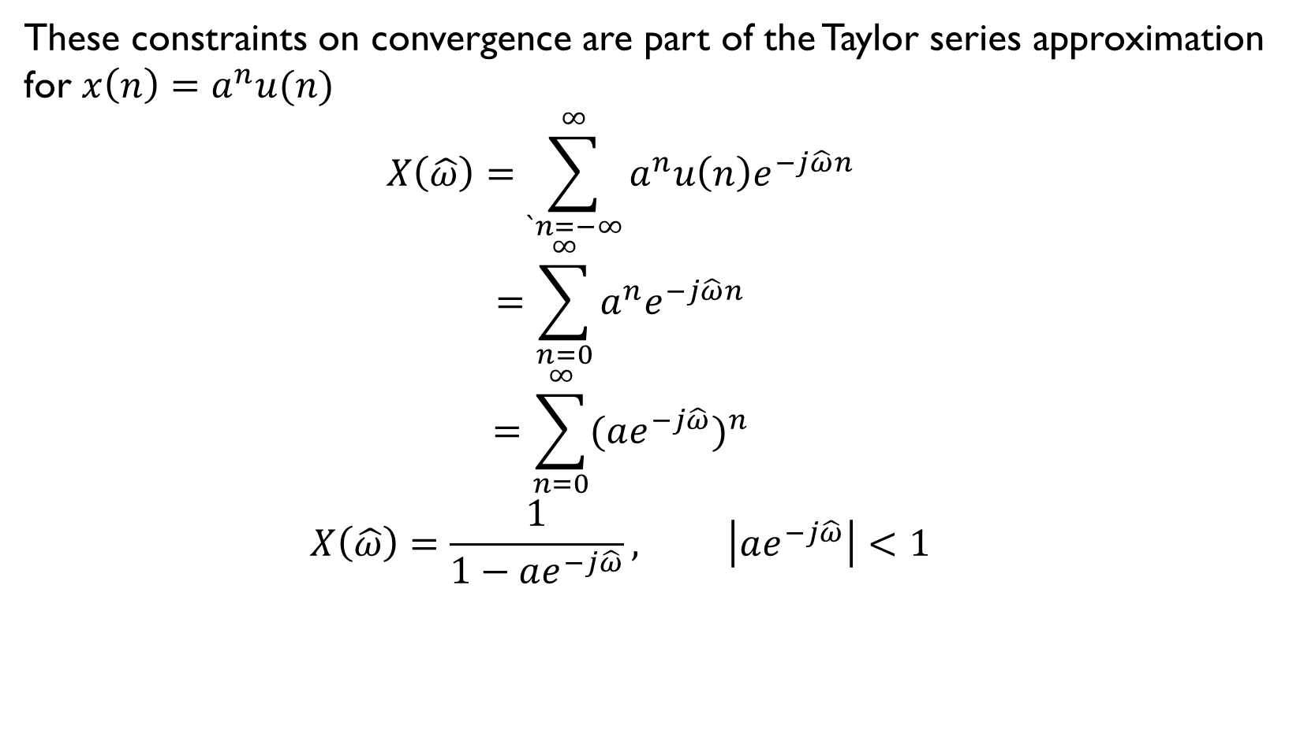
Discrete-Time Fourier Transform - Examples
These constraints on convergence are part of the Taylor series approximation
for $x\left(n\right)=a^{n}u(n)$
$$X\left(\hat{ω}\right)=\sum_{`n=−∞}^{∞}{a^{n}u\left(n\right)e^{−j\hat{ω}n}}$$
$$=\sum_{n=0}^{∞}{a^{n}e^{−j\hat{ω}n}}$$
$$=\sum_{n=0}^{∞}{{(ae^{−j\hat{ω}})}^{n}}$$
$$X\left(\hat{ω}\right)=\frac{1}{1−ae^{−j\hat{ω}}}, \left|ae^{−j\hat{ω}}\right|<1$$
Notes:
Even if the sequence $x(n)$ is absolutely summable, if it’s infinite in length then the algebraic expression for its DTFT is infinite in length too. The Taylor series approximation for a power series can simplify the expression for the DTFT.

Slide 19
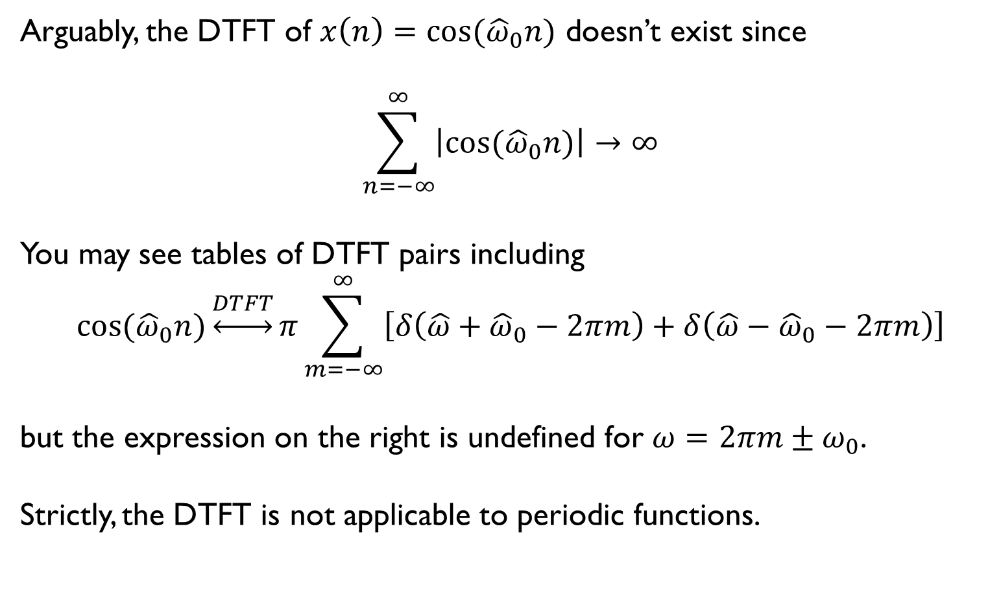
Discrete-Time Fourier Transform - Examples
Arguably, the DTFT of $x\left(n\right)=\cos{({\hat{ω}}_{0}n)}$ doesn’t exist since
$$\sum_{n=−∞}^{∞}{\left|\cos{({\hat{ω}}_{0}n)}\right|→∞}$$
You may see tables of DTFT pairs including
$$\cos{({\hat{ω}}_{0}n)}\underset{↔}{DTFT}π\sum_{m=−∞}^{∞}{\left[δ\left(\hat{ω}+{\hat{ω}}_{0}−2πm\right)+δ\left(\hat{ω}−{\hat{ω}}_{0}−2πm\right)\right]}$$
but the expression on the right is undefined for $ω=2πm±ω_{0}$.
Strictly, the DTFT is not applicable to periodic functions.
Notes:
Although tables of DTFT pairs may include the pair shown here, strictly the DTFT of a sinusoidal sequence doesn’t exist/converge.

Slide 20
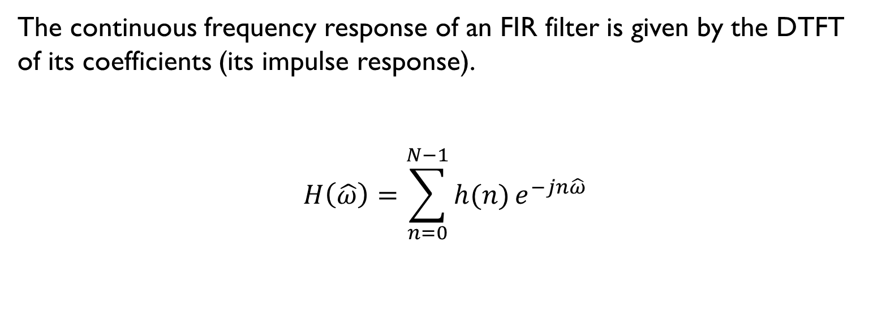
Discrete-Time Fourier Transform and FIR filters
The continuous frequency response of an FIR filter is given by the DTFT
of its coefficients (its impulse response).
$$H\left(\hat{ω}\right)=\sum_{n=0}^{N−1}{h(n)}e^{−jn\hat{ω}}$$
Notes:
A particularly useful application of the DTFT is that it maps between the impulse and frequency responses of an FIR filter.

